Slide 1
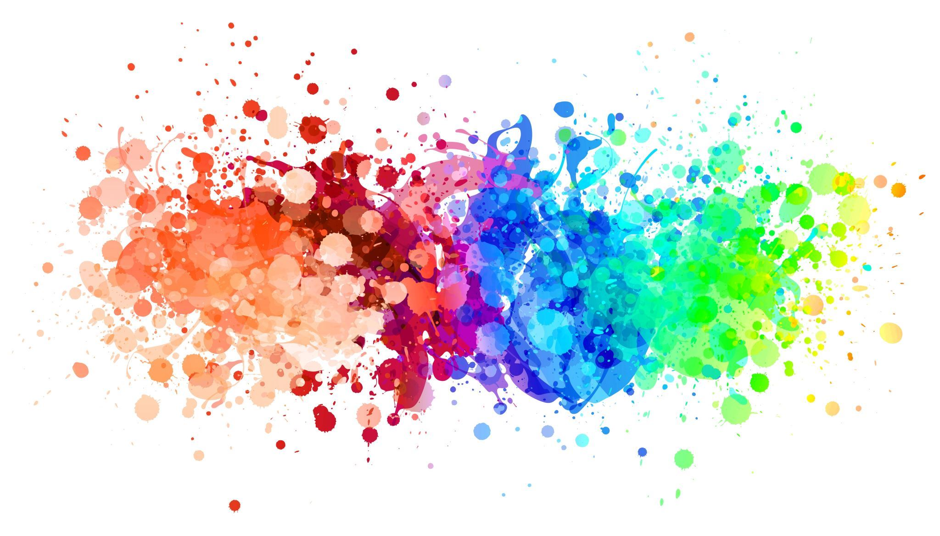
IMAGE COLORISER
NEURAL NETWORKS
AND
DEEP LEARNING

Slide 2
Team Members
NAME | ROLL NO
Sreepadh | CB.EN.U4CSE21009
Boya Abhiram | CB.EN.U4CSE21412
Cheruvu Sahithee vaibhav | CB.EN.U4CSE21414
Khaji Mahammad Sami | CB.EN.U4CSE21430

Slide 3
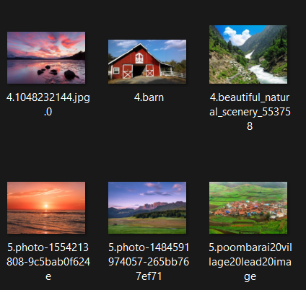
Dataset
Taken From Kaggle
https://drive.google.com/drive/folders/1p9D8t4kZdN8AdP2mM02UHroEkJrF-jcc
Contains Various images on Beaches and Barns.
This dataset contains colorized and diverse images of all natural phenomenon.
This dataset is used effectively for training and reproducing the most realistic colors possible.

Slide 4
Key Stages Involved In The Image Colorization workflow
Input Preparation:
1
Start with an RGB image as the input.
Convert the RGB image into the Lab color space, separating the L* component (luminance) as X and the a* and b* components (chromaticity) as Y.
Autoencoder Training:
2
Utilize an autoencoder architecture to train the model.
Train the autoencoder using X (L* component) to predict Y (a* and b* components).
Prediction Process:
3
For colorization predictions, upload a grayscale image.
Convert the grayscale image into the Lab color space.
Prediction using Autoencoder:
4
Use the L* component of the Lab representation as input to predict the a* and b* components using the trained autoencoder.
Merge Components:
5
Combine the predicted a* and b* components with the original L* component to reconstruct the colorized image.
Result:
6
The final output is a colorized image generated by the autoencoder, showcasing the effectiveness of the model in capturing and predicting chromatic information based on the luminance component.

Slide 5

Procedure rgb -> lab

Slide 6
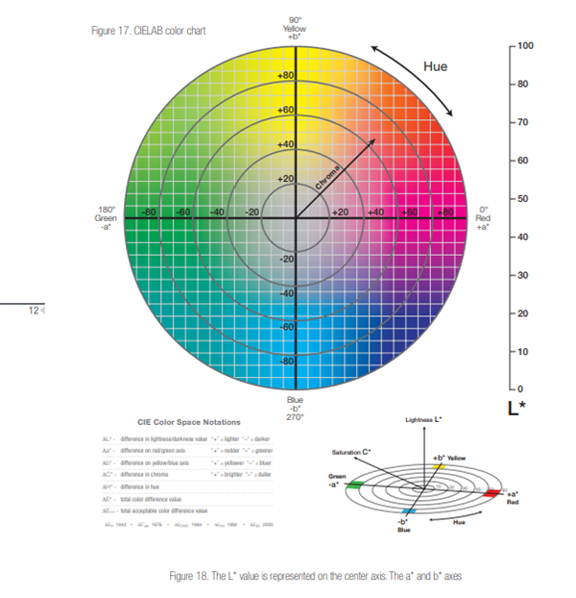
WHAT IS Lab?
What is Lab:
L (Lightness):* This represents the brightness or lightness of the color. The L* axis ranges from 0 (black) to 100 (white).
a (Green to Red):* This axis represents the range from green (-a*) to red (+a*). Negative values represent green hues, and positive values represent red hues.
b (Blue to Yellow):* This axis represents the range from blue (-b*) to yellow (+b*). Negative values represent blue hues, and positive values represent yellow hues.

Slide 7
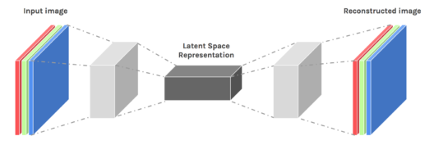
AUTO – ENCODER
Encoder:
The encoder takes input data and transforms it into a compressed representation, often referred to as the "encoding" or "latent space representation."
The encoder consists of one or more layers of neurons that reduce the dimensionality of the input data, capturing its essential features.
Decoder:
The decoder takes the compressed representation from the encoder and attempts to reconstruct the original input data.
Like the encoder, the decoder consists of one or more layers of neurons, but it typically mirrors the architecture of the encoder in reverse.

Slide 8
WHY AUTO ENCODER?
Unsupervised Learning: They can learn from data without needing explicit labels.
Feature Learning: Autoencoders are effective in learning and extracting features from data.
Dimensionality Reduction and Reconstruction: They excel in reducing data to a lower-dimensional space and then reconstructing it, which is vital in tasks like image colorization
Handling Non-Linearity: Capable of capturing complex, non-linear relationships in data.

Slide 9

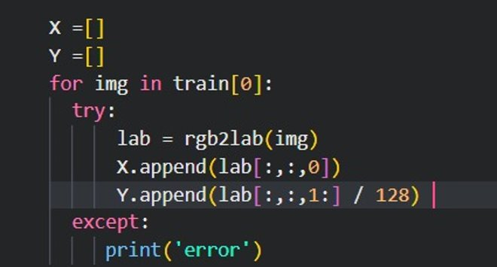
Step-1:input preparation

Slide 10
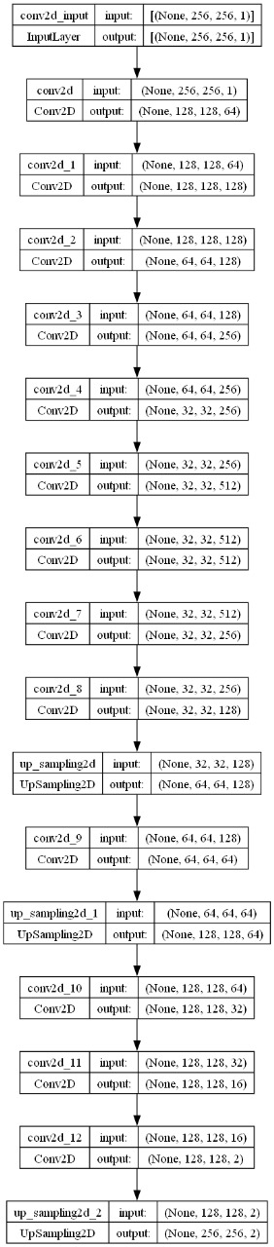
Step 2 : Autoencoder Training (model –1)

Slide 11
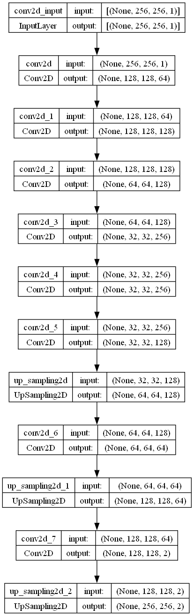
Step 2 : Autoencoder Training (model –2)

Slide 12
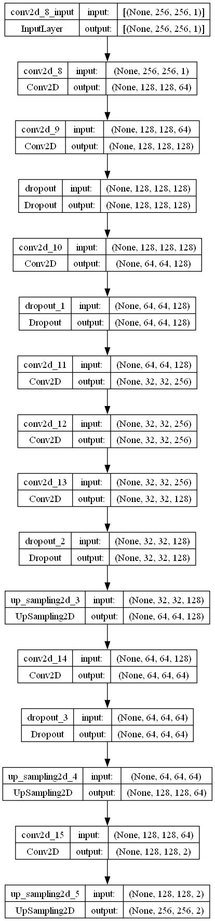
Step 2 : Autoencoder Training (model –3)

Slide 13
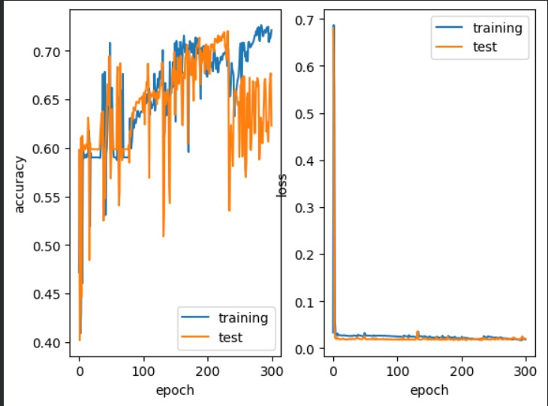
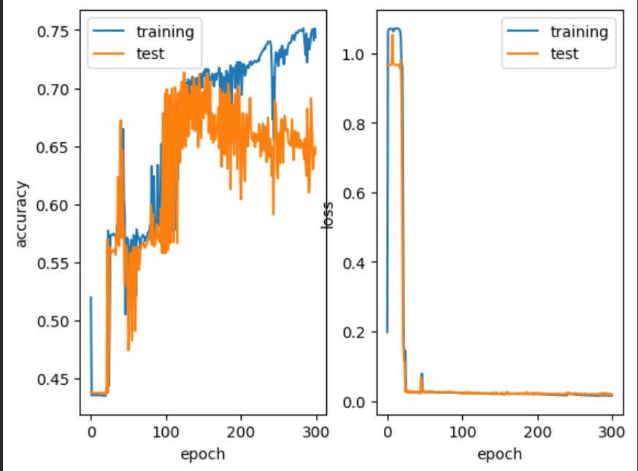
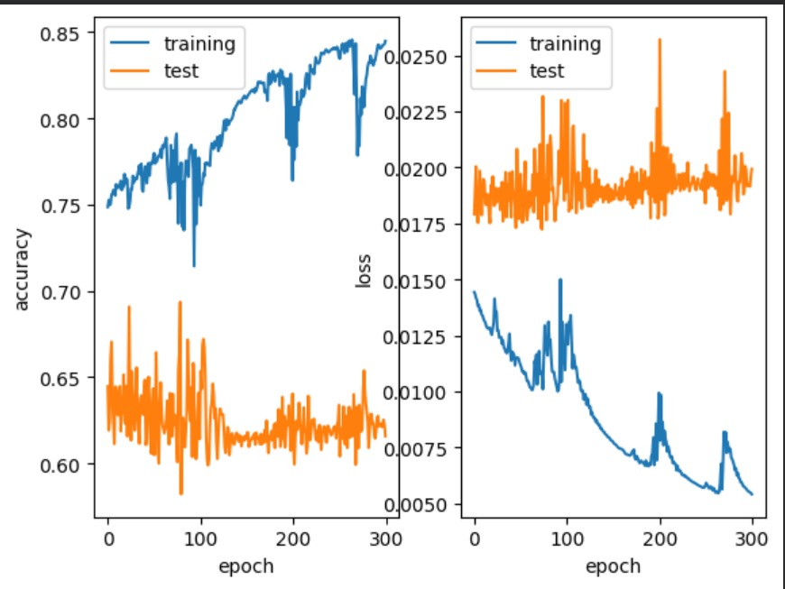
Model 1
Model 2
Model 3

Slide 14
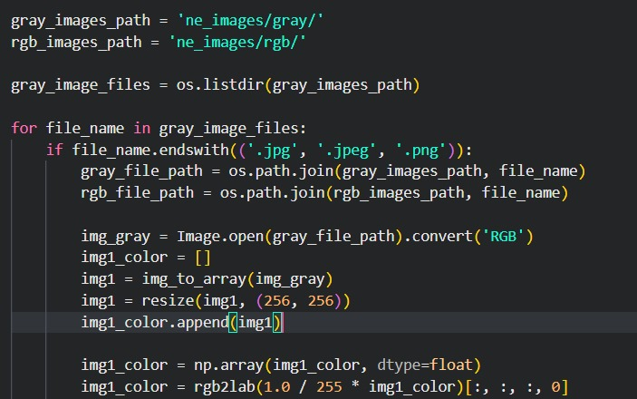
Step-3 : Prediction Process

Slide 15
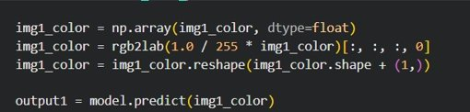

Step – 4 : Prediction Using Autoencoder
Step – 5 : Merge Components

Slide 16
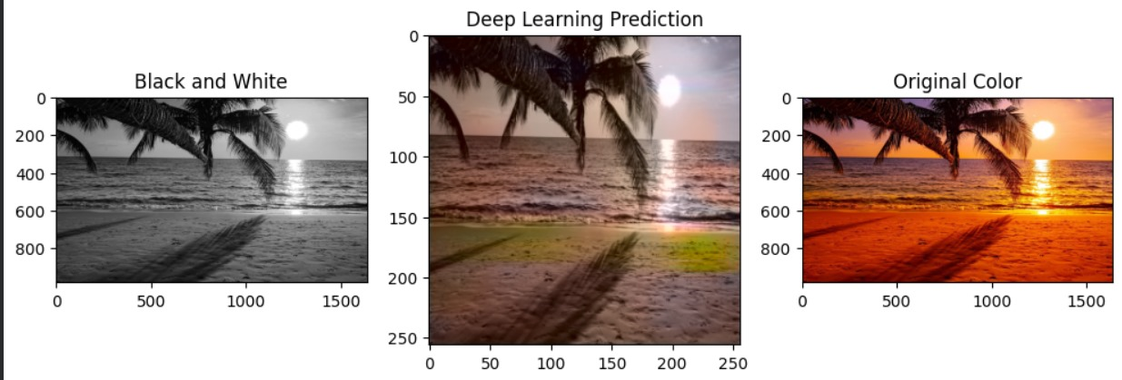
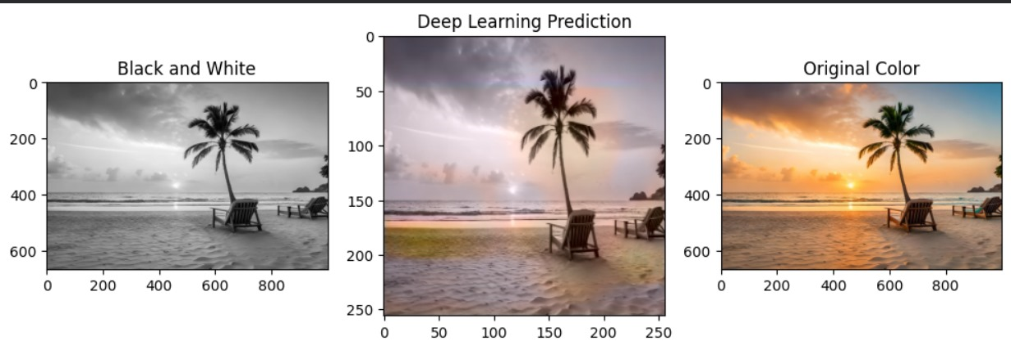
Step-6: result

Slide 17
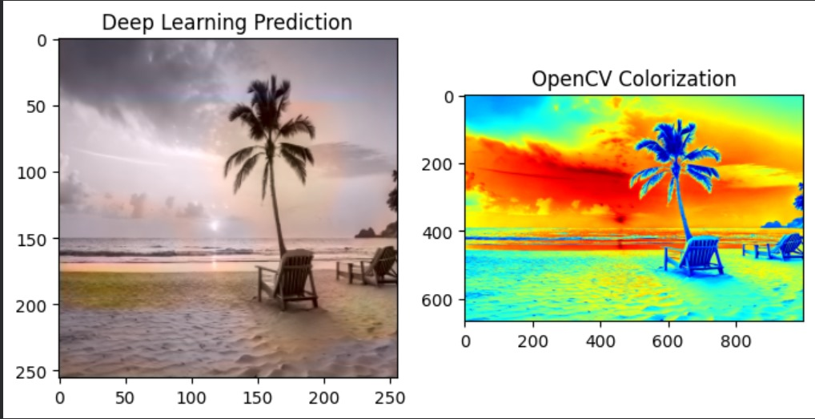
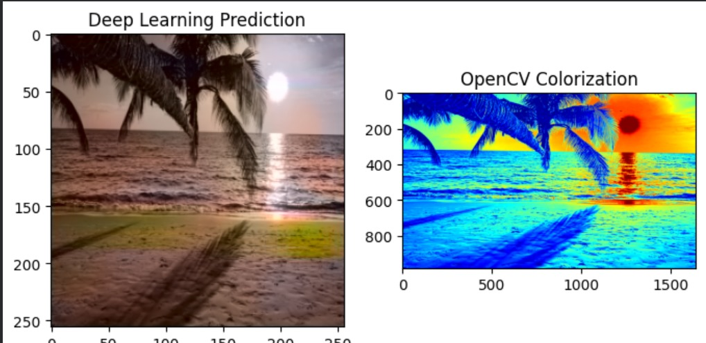
Our Model Vs Open Cv
As we can see Opencv is not performing correctly
It just colorises but no natural colors are present
So our model outperforms open cv

Slide 18

THANK YOU

